Slide 1
Yates Oil and Gas Overview
File created on: 9/3/24 12:38:50 PM PDT

Slide 2


Slide 3
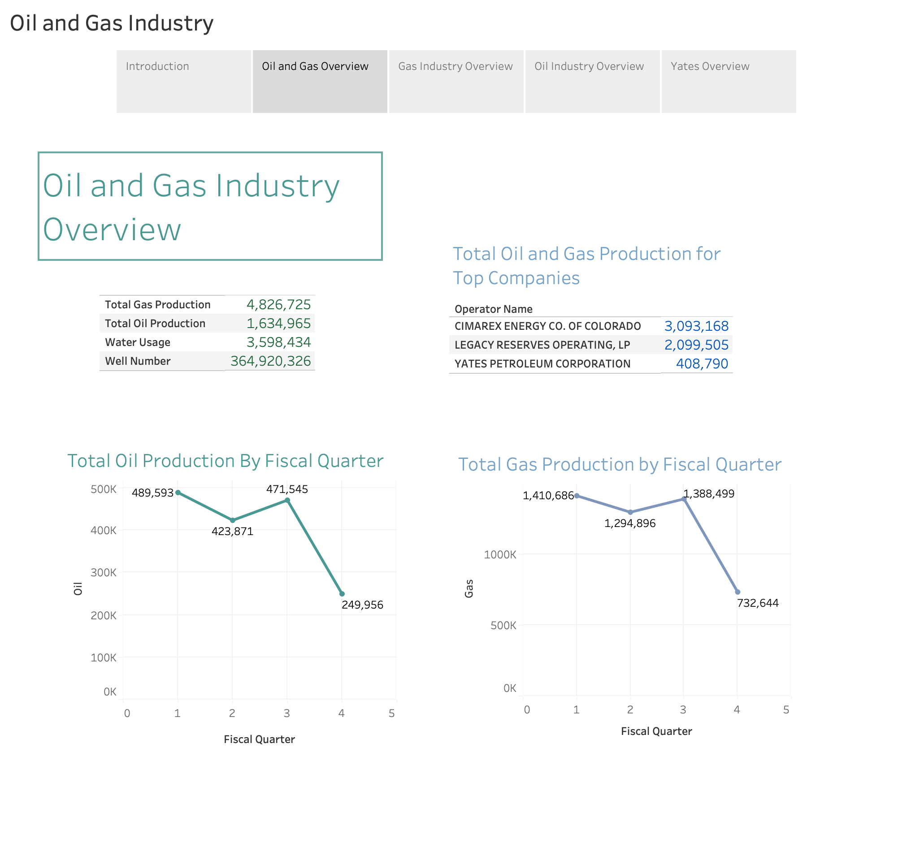

Slide 4
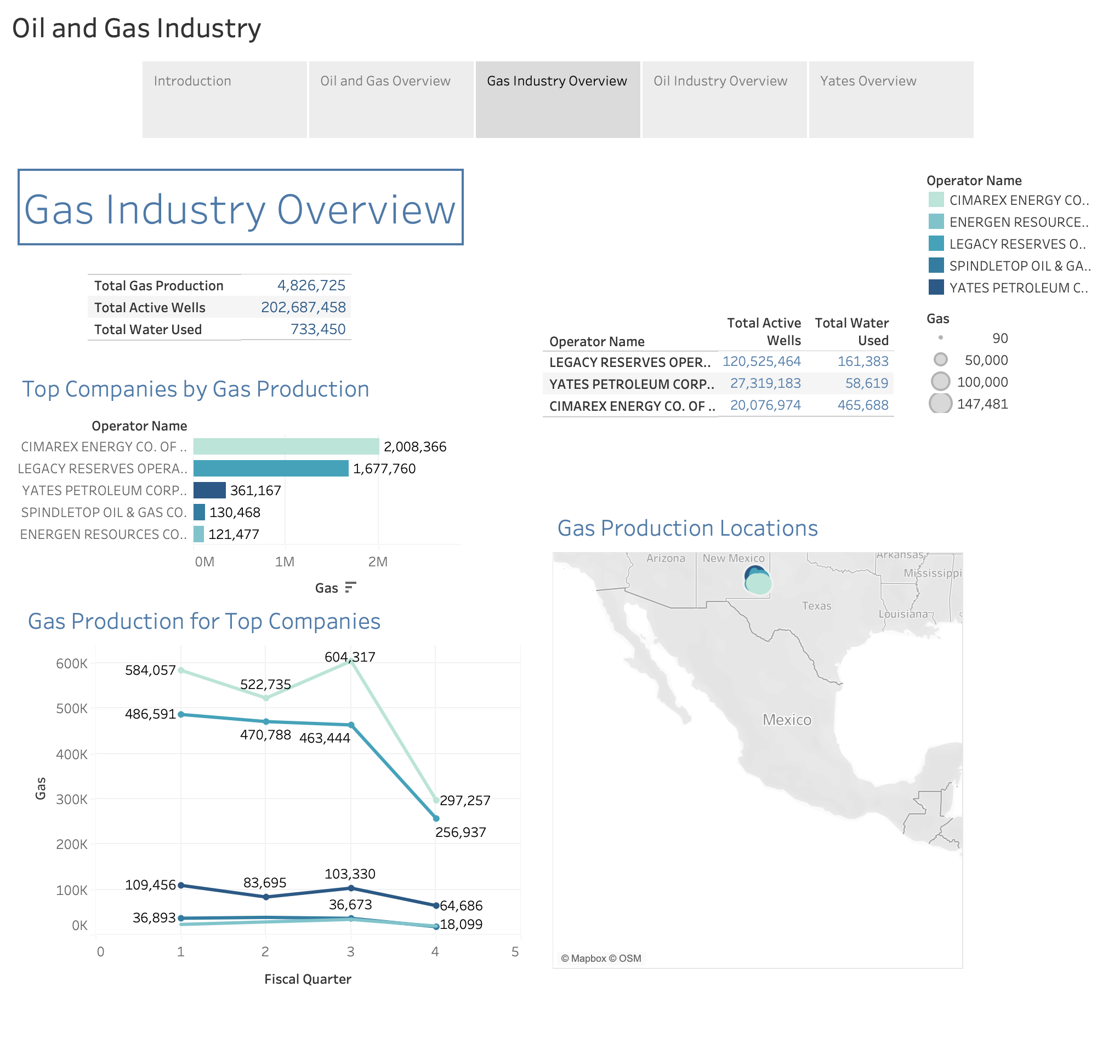

Slide 5
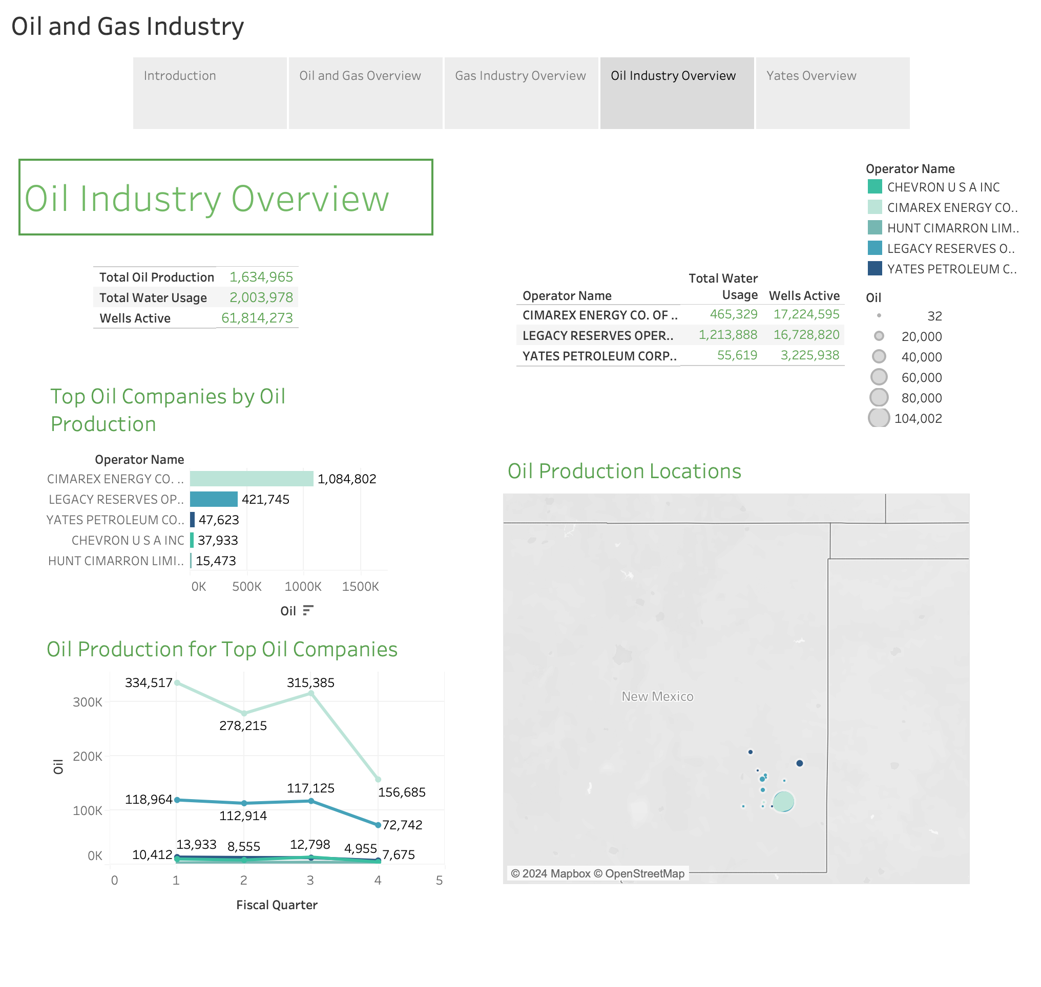

Slide 6
